Slide 1
Chapter
The C++ String
中山大学数据科学与计算机学院

Slide 2
§ The C++ strings
The “string” class
std::string
  A class specifically designed to operate with strings of characters.
  Has many member functions for various operations on strings.
  Also variables to store the content of strings, i.e. characters.

Slide 3
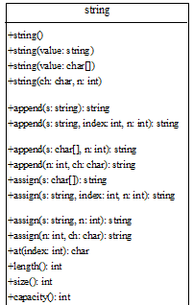
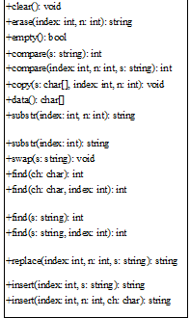
Functions of “string”
string name;
string name(“xxxxx”);
To get the content sequence of a string, in a char array!
http://www.cplusplus.com/

Slide 4
length or size Function
function length returns an unsigned integer value that equals the number of characters currently in the string
function size returns the same value as function length
you must use dot notation in the call to function length or size

Slide 5
find Function
function find returns an unsigned integer value that is the beginning position for the first occurrence of a particular substring within the string
the substring argument can be a string constant, a string expression, or a char value
if the substring was not found, function find returns the special value string::npos

Slide 6
substr Function
function substr returns a particular substring of a string
the first argument is an unsigned integer that specifies a starting position within the string
the second argument is an unsigned integer that specifies the length of the desired substring
positions of characters within a string are numbered starting from 0, not from 1

Slide 7
What is exact output?
#include <iostream>
#include <string> // for functions length, find, substr
using namespace std;
int main ( )
{
string stateName = “Mississippi” ;
cout << stateName.length( ) << endl; // value 11
cout << stateName.find(“is”) << endl; // value 1
cout << stateName.substr( 0, 4 ) << endl; // value “Miss”
cout << stateName.substr( 4, 2 ) << endl; // value “is”
cout << stateName.substr( 9, 5 ) << endl; // value “pi”
return 0 ;
}

Slide 8
Assigning a String
string s1, s2, s3;
s1.assign("Dallas"); // Dallas
s2.assign("Dallas, Texas", 0, 5); // Dalla
string s3("Welcome");
s3.assign("Dallas, Texas", 5); // Dalla
string s4("Welcome");
s4.assign(4, 'G'); // GGGG

Slide 9
Appending a String
string s1("Welcome");
string s2("Welcome");
string s3("Welcome");
string s4("Welcome");
s1.append(" to C++"); // Welcome to C++
s2.append(" to C and C++", 0, 5); // Welcome to C
s3.append(" to C and C++", 5); // Welcome to C
s4.append(4, 'G'); // WelcomeGGGG

Slide 10
Comparing Strings
string s1("Welcome");
string s2("Welcomg");
cout << s1.compare(s2) << endl; // returns -1
cout << s2.compare(s1) << endl; // returns 1
cout << s1.compare("Welcome") << endl; // returns 0

Slide 11
Obtaining Substrings
string s1("Welcome");
cout << s1.substr(0, 1) << endl; // returns W
cout << s1.substr(3) << endl; // returns come(从第3位
开始后面所有的字符)
cout << s1.substr(3, 3) << endl; // returns com

Slide 12
Searching in a String
string s1("Welcome to HTML");
cout << s1.find("co") << endl; // returns 3
cout << s1.find("co", 6) << endl; // returns string::npos
cout << s1.find('o') << endl; // returns 4
cout << s1.find('o', 6) << endl; // returns 9
if (s1.find('GP') == string::npos)
cout << "Can not find GP" << endl;

Slide 13
Inserting and Replacing Strings
string s1("Welcome to HTML");
s1.insert(11, "C++ and "); // Welcome to C++ and HTML
string s2("AA");
s2.insert(1, 4, ‘C'); // ACCCCA
string s3("Welcome to HTML");
s3.replace(11, 4, "C++"); // Welcome to C++

Slide 14
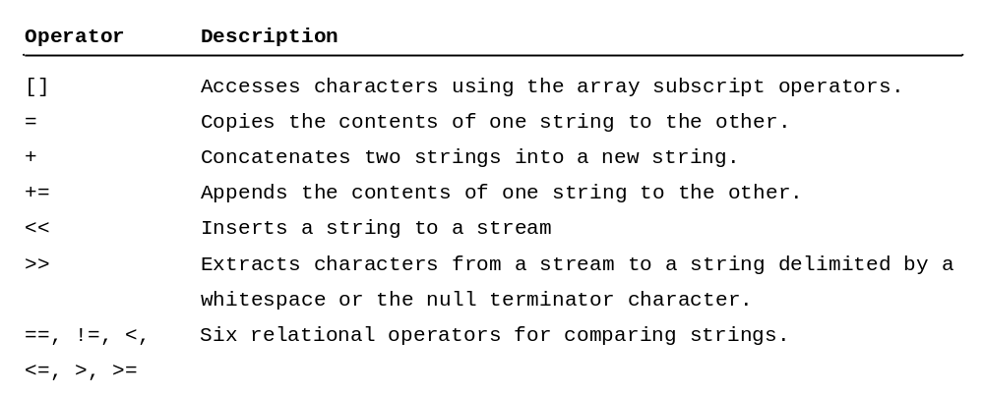
String Operators

Slide 15
String Operators
string s1,s2,s3;
s1 = "Welcome to HTML";
s2 = "and C++";
s3 = s1 + s2 + "!!!";
cout << s3[0] << "..." << s3[19];
if (s1 > s2)
cout << "s1 is bigger than s2!" << endl;
else
cout << "s1 is less than or equal to s2!"<< endl;

Slide 16
Reading Strings
string city;
cout << "Enter a city: ";
cin >> city; // Read to array city
cout << "You entered " << city << endl;
string city;
cout << "Enter a city: ";
getline(cin, city, '\n'); // Same as getline(cin, city)
cout << "You entered " << city << endl;

